Slide 1
Comparison in between Searching Method

Slide 2
Simulation comparison
The local search type is chosen based on simulations.
A typical search space involves enough practitioner for patients.
All the search are based on first fit increasing method. Then the local search is performed.

Slide 3
Late Acceptance (LAHC)
LAHC is a hill climbing method but allow weaker solution to be chosen with criteria. Late acceptance means a solution S’ is accepted if its fitness is still larger than the fitness in L step earlier.
Optaplanner provide option to tweak the late acceptance L parameter. In Optaplanner, L step size is defined as late acceptance size. (note that the KIE optaplanner workbench may not allow the tweaking)

Slide 4
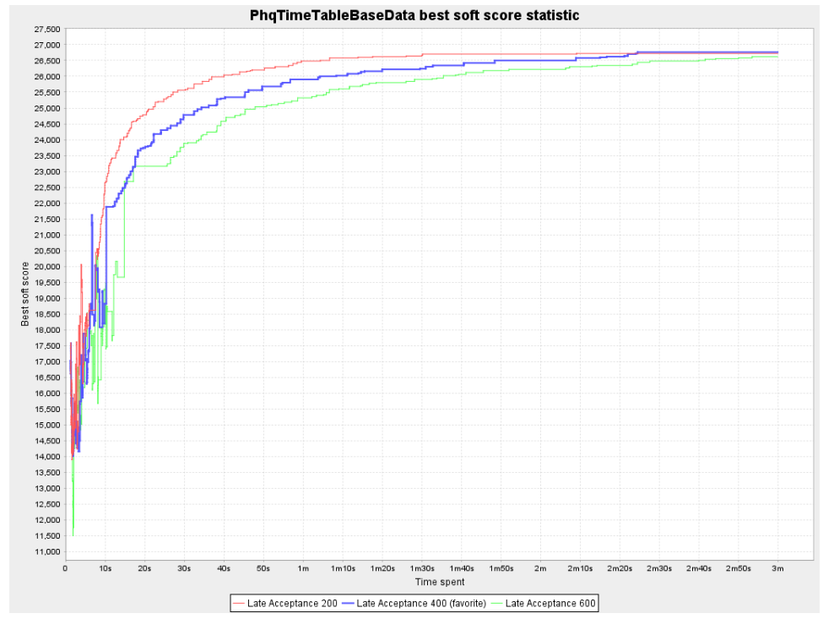

Slide 5
Late Acceptance (LAHC)
Late acceptance size 400 is optimal for optaplanner where it is able to reach maximum score with less time.
Increase acceptance size slow down the convergence speed.
Decrease acceptance size increase the convergence speed but may not be returning the optimal result.
Hence, 400 is a better choice compared to 200 and 600.

Slide 6
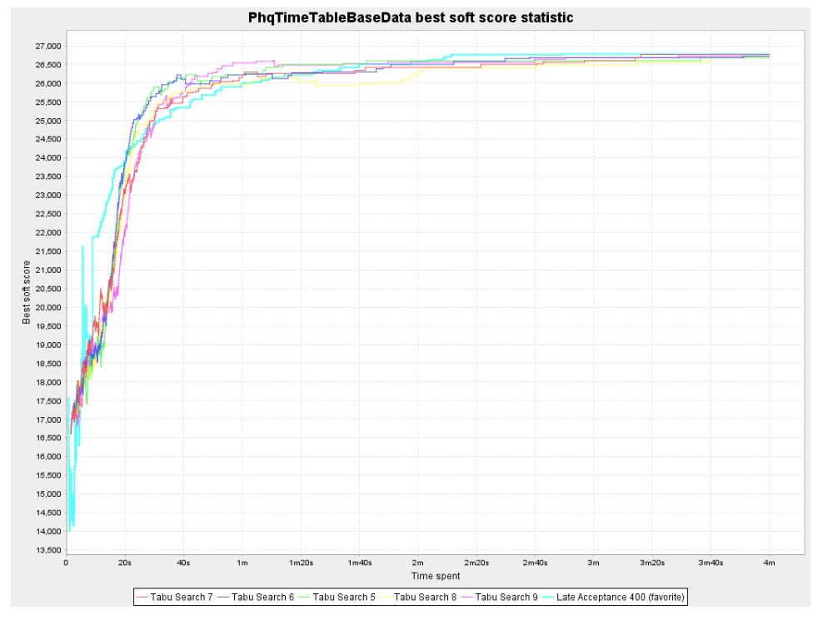

Slide 7
Tabu Search
Tabu means “sacred and untouchable” in a native tribe language.
Tabu search means a local search which do not choose the explored search domain.
Tabu entity size, T specify the search value within T step is not to be repeated.
Thus, tabu search can be used after first fit construction.
Optaplanner allows T to be altered (as Tabu entity size).

Slide 8


Slide 9
Tabu Search
T is found to be optimized as 7 in the problem domain. Increasing T may unnecessarily restrict the value to be repeated while decreasing T may ended with extra searching while not finding the way to get out of local extrema.
Compare with local acceptance with 400 as acceptance size, Tabu search with Tabu size of 7 may be effective in earlier stage but it may not getting into global maxima faster than LAHC.
Hence, LAHC with late acceptance size of 400 is still preferable.

Slide 10
Simulated Annealing
Simulated annealing is derived from the annealing process in forging process. Temperature function decides where the next search to go.
Optaplanner allows simulated annealing to be performed after a certain value of hard/soft score.
In our problem domain, simulated annealing is converging slower than the LAHC with L=400.

Slide 11
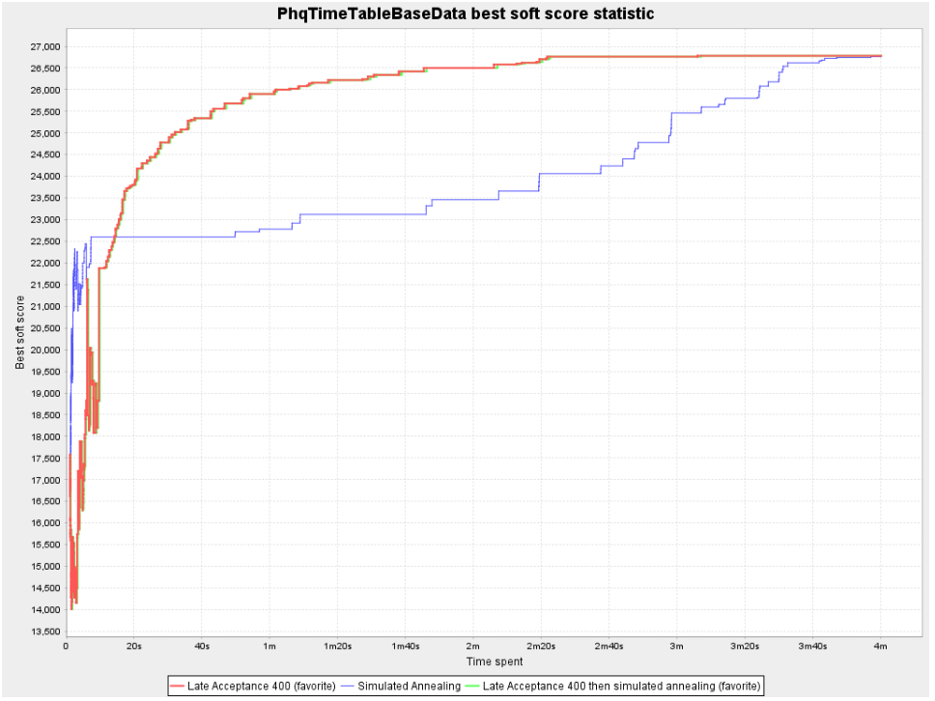

Slide 12
Harder Scenario
In scenario where Tamil speaking practitioners are not available, the search may requires a longer time.
Few type of local search are compared again.
However, LAHC is again giving the maximum count with less time despite the tabu search is still giving a higher score at the beginning.

Slide 13
